Slide 1
Term Deposit Prediction Model BY- DEEPAK KUMAR VERMA

Slide 2
WHAT’S COMING?
PROBLEM STATMENT
TRAINING & TESTING
DATA SET BALANCING
CREATE ENSEMBLE AND TEST IT
RETRAIN ALL MODEL TESTING OUR MODEL AGAIN
EDA
MACHINE LEARNING ALGORITHM
CREATE A FLASK APP
DEPLOY APP

Slide 3
PROBLEM STATMENT :-
There has been a revenue decline for a Portuguese bank, and they would like to know what actions to take. After investigation, they found out that the root cause is that their clients are not depositing as frequently as before. Knowing that term deposits allow banks to hold onto a deposit for a specific amount of time, so banks can invest in higher gain financial products to make a profit. In addition, banks also hold better chance to persuade term deposit clients into buying other products such as funds or insurance to further increase their revenues. As a result, the Portuguese bank would like to identify existing clients that have higher chance to subscribe for a term deposit and focus marketing efforts on such clients.

Slide 4
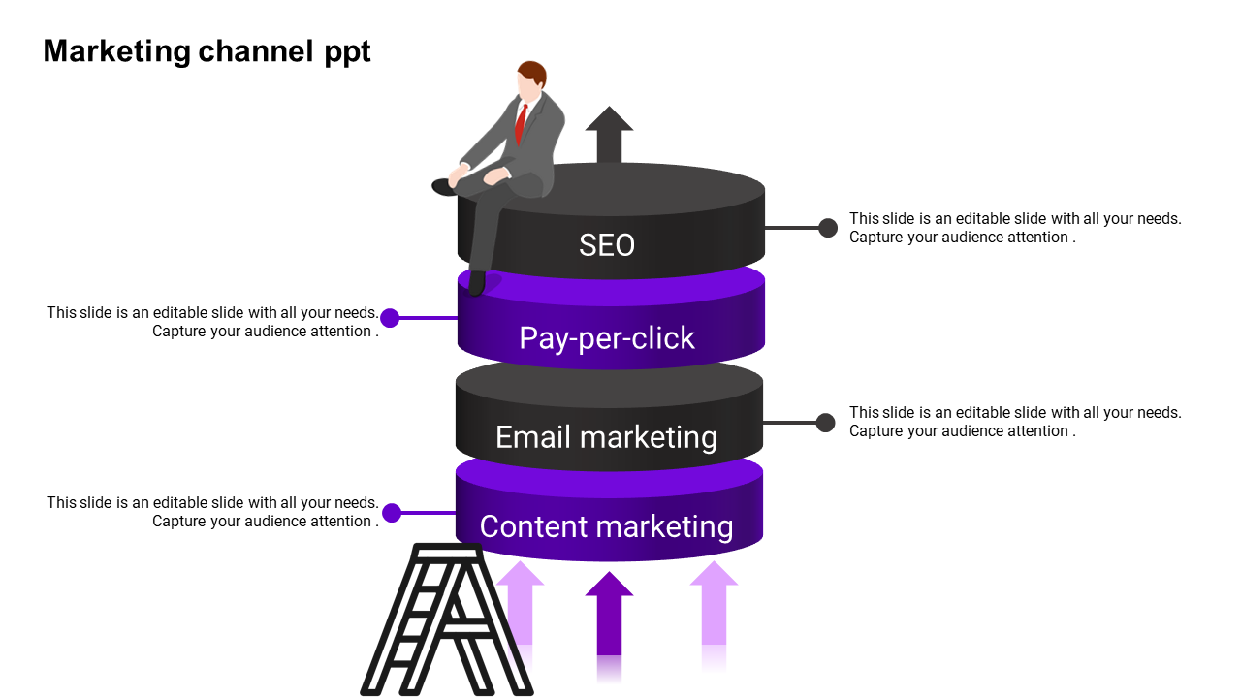
TOOLS USED
PYTHON
For each and every step from EDA to building app..
Designing the frontend for the web app.
HTML, CSS
Flask & Pickle
Used Flask web framework for the backend of the application and pickle to pack our machine learning model
Used Pythonanywhere to host and deploy our web application.
Pythonanywhere

Slide 5
EDA :-
There are a total of 13 independent features and one dependent features.
There are a total of 32950 rows of data available.
The datatypes of all data is Int64.
There are a total of 55 duplicated rows. These rows will be removed as they may create bias in our mode.
There are no null values present in our data, so there is no need to handle null values.
To understand the data, we will find the statistical summary.
We will find the correlation of the dataset and print a heatmap.
From the heatmap, we can see that there is less correlation between the loan and y. Therefore, we can drop this column.

Slide 6
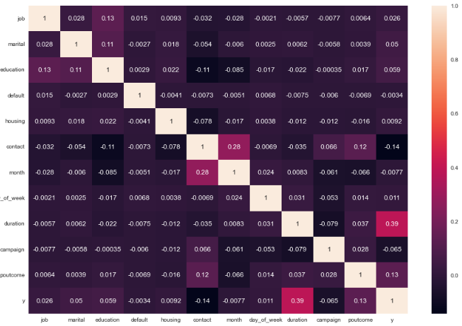

Slide 7
Another insight is that age and marital status are highly correlated, which may create multicollinearity in our dataset. Additionally, age is less correlated with y. Therefore, we can drop age as well.
We will find the outliers using box plots. However, there are no outliers, so we can move forward.

Slide 8
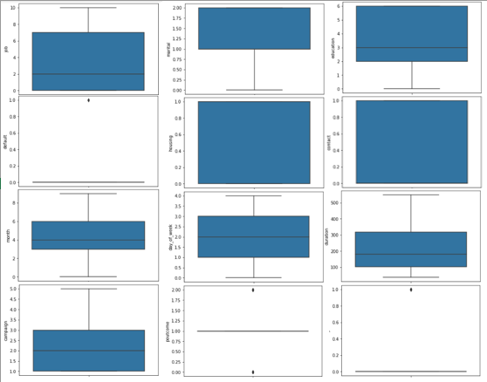

Slide 9
We will divide data into X- independent features and y- dependent features.
We will Split data into train and test and apply standard scaling.

Slide 10
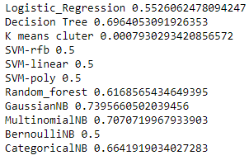
MACHINE LEARNING ALGORITHM :-
Since this is a classification problem, some popular machine learning algorithms such as Logistic Regression, KMeans, Decision tree, Random Forest, Navie Bias, Support vector machine can be used. We apply each model and perform hyperparameter tuning to achieve maximum accuracy and roc auc score.
We have calculated the roc auc score for all the models.

Slide 11
Based on the roc auc score, I have selected the top 6 models for this dataset, which are GaussianNB, MultinomialNB, Decision Tree, CategoricalNB, Random Forest and Logistic Regression
When I checked the classification report of all top 6 models, I found that the MultinomialNB model had a problem. Its accuracy for predicting 1 was only 28%, so I will not using this model further.

Slide 12
BALANCING OUR DATASET :-
Since our model’s accuracy is less than 75%, it is possible that this is due to an Imbalanced dataset. To address this, we need to balance the dataset using one of three popular methods.
The first method is undersampling, which involves reducing the size of the majority class to match the size of the minority class. However, in our case, we have less data for 1, so this method is not useful.
The second method is oversampling, which involves increasing the size of the minority class to match the size of the majority class. This can be done by duplicating the minority class data points.
The third method is SMOTE(synthetic minority over-sampling technique) it’s also a oversampling method. It involves generating synthetic data points for the minority class by interpolating between existing minority class data points. We will use his method.

Slide 13
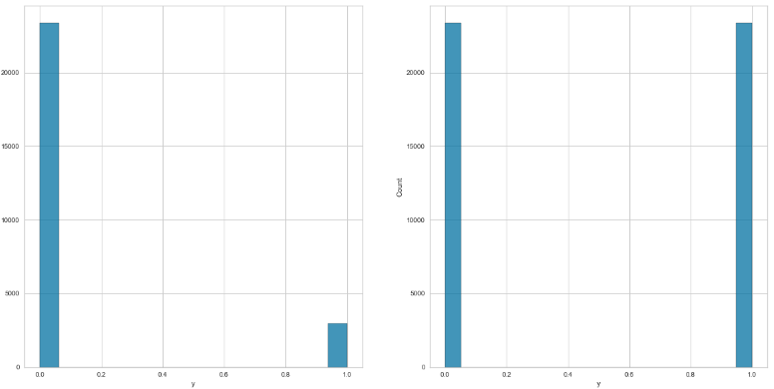
Distribution of data before and after SMOTE

Slide 14
TRAINING & TESTING MODEL AGAIN :-
Thus, we retrained our models using the new balanced training dataset and the old hyperparameter. We then predicted y for thee testing dataset and obtained the roc auc score for each model, comparing it with the old roc auc score.

Slide 15
After analyzing the new balanced training dataset, we found that some models perform better while others have slightly lower roc auc scores compared to the old dataset.
In order to improve the results, we used an ensemble technique that combines the top 5 models’ results using the majority rule.
We obtained the roc auc score for our ensemble model.
0.8289

Slide 16
CREATE A WEB APP & DEPLOYMENT :-
Saved model and scaling function as separate pickle files named ‘Model_pkl and normalizer_pkl”.
Create html and Css files for the frontend of the application
Used Flask as the backend framework to connect the HTML files and pickle
The application takes 13 input from the user
Flask flash messages are used to display the model’s predictions on the frontend
Hosted the application on pythonanywhere.

Slide 18


